Slide 1
Enhancing Socio-economic Benefits of the Mining Industry in Tanzania: Ten (10) Key Priorities
Jambo H. Ramadhani UONGOZI Institute

Slide 2
Presentation Outline
Tanzania’s wealth in the mining sector
Tanzania’s aspirations on the mining sector
Growth of the mining sector and its contribution to GDP
Initiatives in managing Mining sector
Key challenges in managing mining sector in Tanzania
Ten key priorities

Slide 3
Tanzania’s wealth in the mining sector
Ranks forth in Africa in terms of diversity and richness of mineral resources Eg. 10% of Africa’s Gold is in Tanzania
The first three countries are South Africa, DRC and Nigeria

Slide 4
Tanzania’s aspirations on the mining sector
Tanzania wishes to enhance the competitiveness of the sector and contribute to the socio-economic benefits in terms of:
Job creation
Skills development
Participation of local community across gender
Inter-linkage with other sectors of the economy
Sharing of the benefits
GDP contribution
Increase of exports
Environmental sustainability

Slide 5
%Growth of the mining sector and its contribution to GDP
YEAR | Contribution to GDP (%) | Sectoral growth (%)
2000 | 1.5
2001 | 1.8
2002 | 2.1
2003 | 2.4
2004 | 2.6
2005 | 2.9
2006 | 3.2
2007 | 3.5
2008 | 3.4
2009 | 3.3 | 1.2

Slide 6
%Growth of the mining sector and its contribution to GDP
YEAR | Contribution to GDP (%) | Sectoral growth (%)
2010 | 3.3 | 2.7
2011 | 3.3 | 2.2
2012 | 3.5 | 7.8
2013 | 4.2 | 6.9
2014 | 3.7 | 9.4
2015 | 4.0 | 9.1
2016 | 4.8 | 11.5
2017 | 4.8 | 17.5
Source: ECONOMIC SURVEY OF TANZANIA REPORTS

Slide 7
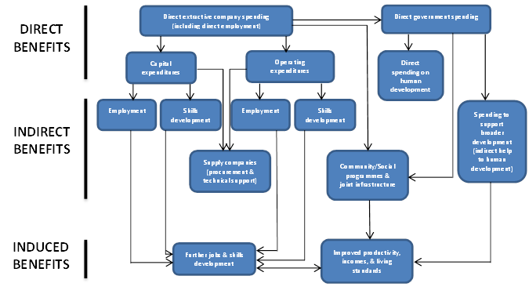

Slide 8
Tanzania’s initiatives in managing mining sector
The country has attempted to review policy, regulatory and institutional frameworks governing mining and natural resources all together:
1. Policies and Strategy for managing mining sector
Tanzania is among the signatories to the AMV, which is in line with Tanzania’s LED approach as well as the aspirations of the national FYDP II.
Strategies to promote institutional coordination, information management and public participation
Eg. Coordination btn MoM, MRI, STAMICO, TGC, mines commission etc.

Slide 9
2. Accountability and Transparency
Open public discussion on policies related to mining sector are now promoted
Commitment to the global (EITI) and passing of Tz Extractive Industry(Transparency and accountability) Act 2015
Official oversight bodies (National Audit, National Assembly, PCCB, PPRA, Ethics Secretariat etc.)
Informed public via media and other live platforms

Slide 10
3. Managing impact on environment and people
Strategic Environment Assessment (SEA) is currently a legal requirement
Local Environment Impacts are now assessed prior to awarding of mining rights (EIA)
CSR and contractual obligation to undertake community dev programs
Local content

Slide 11
4. Securing fiscal returns
Renegotiations of Mining Dev Agreements (MDAs) to maximize tax revenue
Tanzania’s parliament passed three pieces of legislation on 3 and 4 July 2017
the Written Laws (Miscellaneous Amendments) Act 2017,
The Natural Wealth and Resources (Permanent Sovereignty) Act 2017 and
(3) The Natural Wealth and Resources (Revenue and Re- Negotiation of Unconscionable Terms) Act 2017.
The written laws (Miscellaneous Amendments) No.2 Act 2019 has removed withholding tax(5%) and VAT on supply payable by ASM
Mineral centers & germ houses and Mererani wall

Slide 12
5. Diversification and linkage to wider economy
Local content policy
Strong non-resource economy;
Providing most jobs and income
Business environment

Slide 13
Key challenges in managing mining sector in Tanzania
Piecemeal strategies
Contract disclosure (lesson from Ghana, DRC, Guinea, Peru etc.
Geological information
Comprehensive Fiscal regime
Effective and efficient enforcement of SEA
Capacity esp to our SEOs
Clear F/W for allocating revenue from mining

Slide 14
Ten key priorities
1. Contracts disclosure
TEITA Act 2015 passed but no regulations to operationalize it
The transparency environment remains fairly opaque, hindering the verification of information.
The provision on contract disclosure is unclear on whether it also applies to contracts signed prior to the TEITA Act, or whether it only applies to contracts signed subsequently.
Ghana and DRC have made contracts available online

Slide 15
Ten key priorities cont.
2. Investing in geological information
Information asymmetry.
No clearer picture of the country’s resource wealth
Pre-licensing investment in geological and geophysical surveys funded by the Government can provide a high return on government investment
Resulting information increases the attractiveness of the geology to investors. This, in turn, attracts higher bids (Papua new Guinea provide interesting case study)

Slide 16
Ten key priorities
3. Taxation
Rethink the basis of taxing the extractive sector
Consider the mixed-basis approach of capturing tax at inputs, revenue and profit tax points to limit the scope for corporate tax planning as opposed to the use of profit basis taxation.

Slide 17
Ten key priorities
5. Protection of the environment
Formulating the outstanding Environmental Management Act (EMA) 2004 regulations that relate to the extractive sector.
6. Community beneficiation
Develop a local participation framework to ensure that local communities and local governments are involved in project processes prior to project development. This will make communities understand how they will be affected, plan for the pending changes, and contribute local knowledge to the design of mitigation strategies.
Develop a framework for CSR to be adopted by all communities to ensure long lasting benefits, such as infrastructure development.

Slide 18
Ten key priorities
7. Mining revenue volatility
Urgently invest in building the capacity of the revenue management authorities to estimate revenue forecasts which will help the Government to investigate the vulnerability of its own finances and the economy of Tanzania to revenue fluctuations resulting from extractive resource price movements.
Lessons from Zambia

Slide 19
Ten key priorities
8. Free mineral marketing across regions
9. Clear Framework for Mining revenue distribution
10. “Investing in investing”

Slide 20
Thank you

